Slide 1
Padding Attacks POODLE
Padding Oracle on Downgraded Legacy Encryption
SSLv3 with block cipher CBC mode

Slide 2
Goals
Implement attack from scratch
Understand the details
Set up environment for defense
Create useful visualization
What’s going on under the hood
Implement a defense
Will it blend?

Slide 3
POODLE Overview
Attacker
MitM
4
HTTPS Server
Oracle
3
Client
Browser
5
6
1. Client browses Attacker HTTP server
2. Attacker server injects HTTPS request generator
3. Client sends HTTPS request with secret cookie
Attacker intercepts and modifies HTTPS request
4. Attacker forward modified HTTPS request
5. HTTPS server acts as oracle
Attacker deciphers byte
6. Attacker updates request generator
Trigger client to update request, repeating steps
2
1
Attacker
HTTP Server

Slide 4
SSLv3 Vulnerability 1
Random Padding
Only the last padding byte is examined; an SSLv3 server will accept any padding as long as the last byte is between 0..(b-1)

Slide 5
SSLv3 Vulnerability 2
MAC-Then-Encrypt
SSLv3 HMAC does not include the padding, only PT message
A full block of padding at the end of an encrypted message may be replaced with an arbitrary block of data
E_{CBC}[K_{sess}, plaintext-message ‖ 20-­byte MAC ‖ padding]

Slide 6
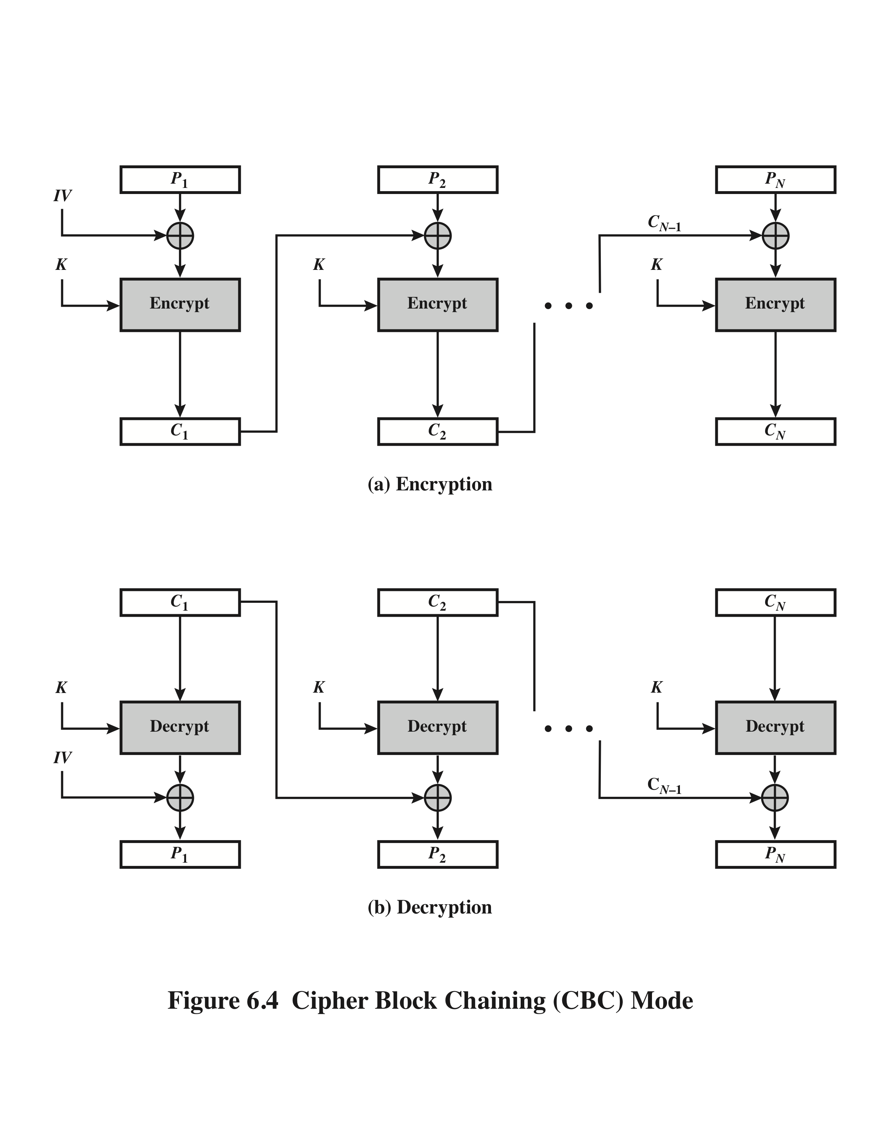
16-byte blocks
secret cookie
padding (full block)
Pi-1
Pi
xxxxx15
Attacker Manipulation of C₀||C₁||…||C_{n}
- Last byte of P_{i} contains byte of secret cookie
- Replace C_{N} with C_{i} of choice
- If Oracle success, attacker knows:
1. D_{K}(C_{i})[15] ⊕ C_{n-­1}[15] = 15
2. D_{K}(C_{i}) = P_{i} ⊕ C_{i-1}
3. D_{K}(C_{i})[15] = P_{i}[15] ⊕ C_{i-1}[15] Bitwise
4. (P_{i}[15] ⊕ C_{i-1}[15]) ⊕ C_{n-­1}[15] = 15 Substitute
5. P_{i}[15] = 15 ⊕ C_{n­-1}[15] ⊕ C_{i­-1}[15]
Ci-1
Ci
Cn-1
Ci
Cn-1
Ci
Ci-1
Dk(Ci)
Dk(Ci)
Ci-1
2., 3.
1.
Pi
Pn-1
xxxxx15

Slide 7
POODLE Attack Steps
Will demo…

Slide 8
Defense: Record Splitting
Browser implementation
6/n-6 record split to maximize MAC spread into padding block
Split if encryption layer receives a message with integral block length
length(message + MAC) % 16 == 0
Both records are then independently MAC’d, padded, and encrypted
Decreases probability attacker can both the final byte of padding AND 10 bytes of MAC in the last block from 1/256 to 1/2⁸⁸ = 3.23x10⁻²⁷
Drawback: requires correct server handling

